Slide 1
Debrief 20/04/23

Slide 2
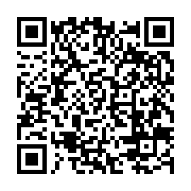
Survey
https://tomowork.typeform.com/to/zCli2Wih

Slide 3
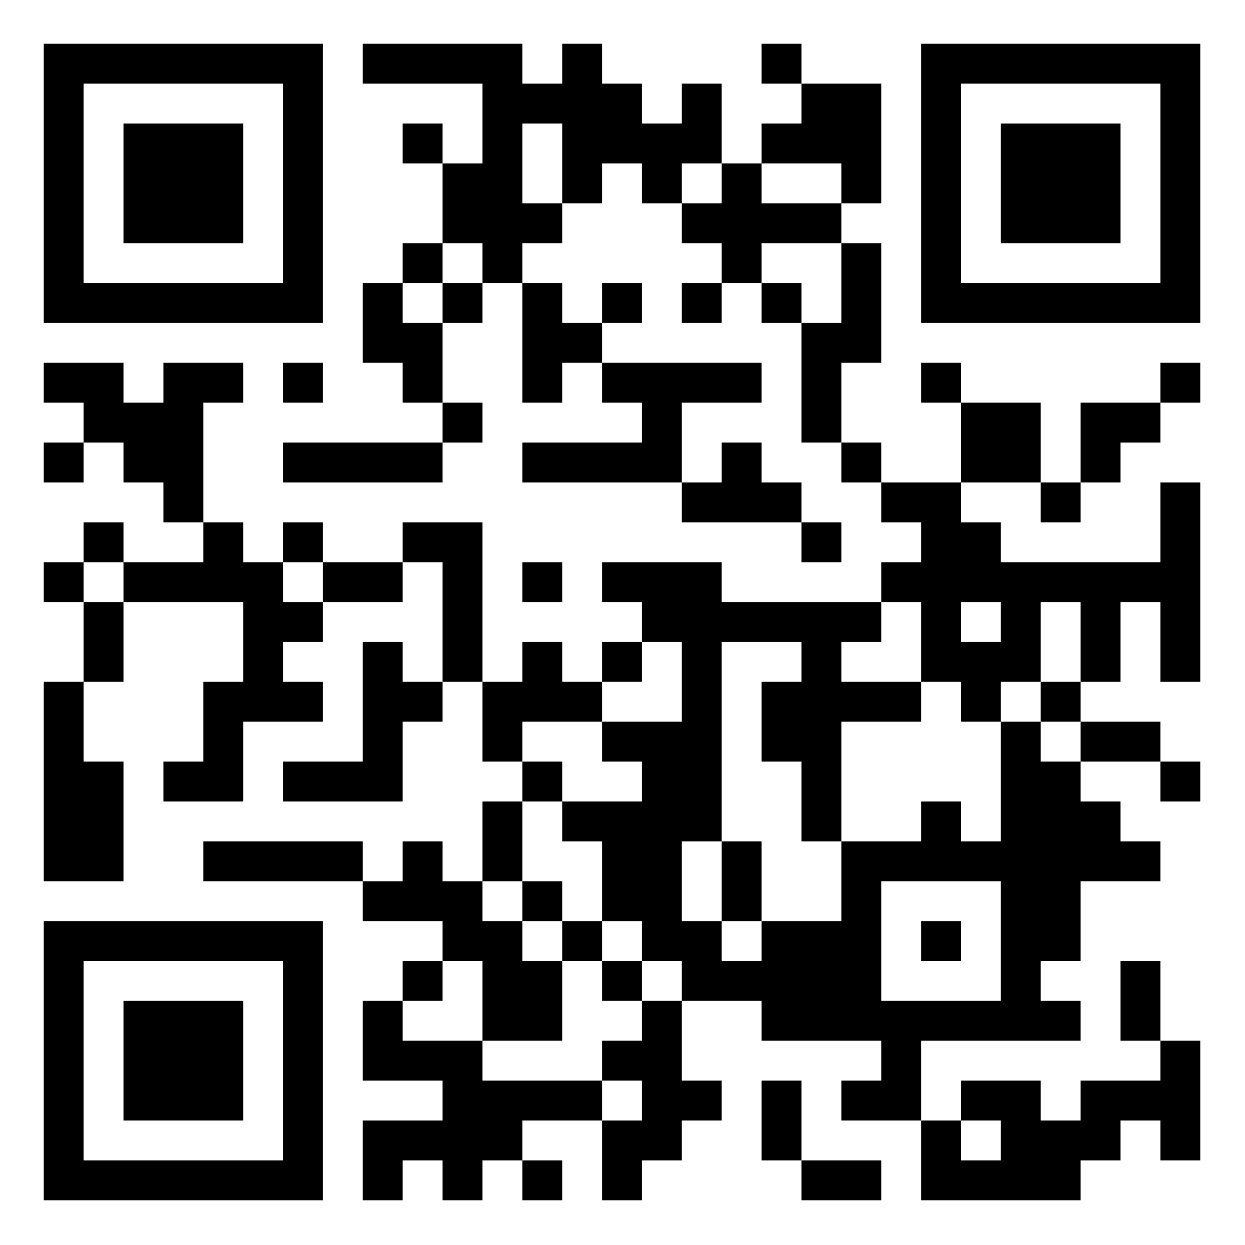
Reflection
https://padlet.com/woeiluen/tap-2023-weekly-reflection-week-6-z0n1v8xayqqrjvgh

Slide 4
Programme for 25th April 2023 (Tuesday)
Time | Event | Venue
9.50am | Report to Republic Poly
10am -12.30pm | Corporate project | Classroom E19A – Kinjo Rubber LIBN1 – MSD LIBN2 – foodpanda LIBN3 – EVCO LIBN4 - Micron
12.30pm – 2pm | Lunch
2pm - 4pm | Corporate project
4pm – 4.30pm | Debrief
4.30pm | Dismissal
Things to Bring: Laptop with Charger, money for lunch, writing materials and handphone
Wear: Smart Casual

Slide 5



Week 7 Mid-Term Review
 | Monday 24 April | Tuesday 25 April | Wednesday 26 April | Thursday 27 April | Friday 28 April
10.00am to 12.30pm | Public Holiday Off-in lieu Hari Raya Puasa | Corporate Project Mid-Term Review Prep | Job Readiness Corporate Career Sharing Standard Chartered Talk | Job Readiness Workshop – Organisational Skills by SP | Digital Skills Learning
12.30pm to 2pm | Lunch Break | Lunch Break | Lunch Break | Lunch Break | Lunch Break
2pm to 4.30pm | Public Holiday Off-in lieu Hari Raya Puasa | Corporate Project Mid-Term Review Prep | Job Readiness Corporate Career Sharing Standard Chartered Talk | Mid-Term Review Meeting Project Sponsors 4 | Digital Skills Learning
In-person session at
Republic Polytechnic
Work From Home (WFH)
Flexible arrangement
Company Visit

Slide 6
HomeWork
Please work on CV Draft 2 this long weekend
Please craft such that you will want us to include inside the CV Book for us to circulate to partners
Include your experience in TAP as job experience as if you have already completed the project
Include your e-learning certification in TAP as If you have completed the certification

Slide 7
Common Mistake
Not using STAR Statement / Not describing impact
Did not do spell-check and grammar check.
Some sentence have full-stop while some don’t (if put one, all put, if not all don’t put)
Trying too hard in the summary for KSAEE (if don’t have expertise or abilities, please do not indicate)
COPY AND PASTE FROM OLD CV

